Slide 1



Introduction to National Coaching Accreditation Scheme
Waterski & Wakeboard Australia
admin@awwf.com.au
08 9361 1005
December 2024
Notes:
Advanced User Systems is the Australian distributor for Commence.
We provide full sales, support, training and consulting services.
We work through business partners to provide the Commence CRM solutions.

Slide 2
Agenda
NCAS.
Courses.
Benefits.
Level 1 - Water Ski Coaching.
Notes:
This presentation will take about 15 - 20 minutes and will cover
some background on Commence Corporation: who they are where they have come from, etc
we will then look at the CRM question: what the problem is and how to solve it
then we will look at the Commence CRM solution in more detail
Finally, we will show you a demo of Commence itself.

Slide 3
National Coaching Accreditation Scheme (NCAS)
Managed by Australian Sports Commission.
Progressive education program – up to 4 levels.
Nationally recognised qualification.
Over 90 sports participate.
Levels set by National Sporting Body.

Slide 4
Objectives
Confidence and competence in coaching.
Improvement in knowledge and expertise.
Safe and correct techniques.
Consistency in coaching.
Understanding of sports science.

Slide 5
Level 1
ASC online course Beginning Coaching General Principles. 4 hours.
7 hours sport specific.
16 hours coaching practise.
Working with Children Check.
Covers all disciplines of water skiing.

Slide 6
Level 2
35.5 hours coaching principles.
30 hours sport specific.
60 hours coaching practice.
Specific to a particular discipline of water skiing.
Level 2 manuals written for Barefoot and Tournament.

Slide 7
Level 3
100 hours advanced sport
100 hours coaching practise
Level 3 course has not been developed for water skiing
High Performance course - individually tailored to leaders in high performance coaching

Slide 8
Updating
Every 4 years fulfil updating requirements.
Complete a statement of coaching over the period.
coaching at club, state, national level.
Pay the update fee.

Slide 9
Benefits of NCAS registration
Nationally recognised qualification.
Bi-annual NCAS Newsletter.
NCAS identification card.
Update log-book and sports specific policy.
Discount on NCAS coach pack.
Discount on ASC coaching resources.

Slide 10
Level 1 Accreditation - Water Skiing
Level 1 Coaching Accreditation Course
Check registration details including DOB and sign.
Sign Code of Ethics Agreement form.
Sign Prohibited Employment Declaration & Screening.
All should now have been completed.
16 hours coaching practise
Statement signed by divisional coaching director or office bearer, NSWWSF director, AWSF director or L1 Coach.
Passing level 1 coaching exam
Distributed at the end of this course, open book, to be returned within 14 days.

Slide 11
Course Agenda
See agenda in hand outs.
Notes:
Xm,nxbcm,bnvmadfjvdfvadfv
J,hhjgjgZXjhc

Slide 12




Water Ski Organisational Structure
Waterski and Wakeboard Australia
admin@awwf.com.au
08 9361 1005
December 2024
Notes:
Advanced User Systems is the Australian distributor for Commence.
We provide full sales, support, training and consulting services.
We work through business partners to provide the Commence CRM solutions.

Slide 13
Why bother understanding the organisation ?
Organisers for competition.
Manage membership.
Peak bodies - representation to Government agencies.
Arrange insurance.
International involvement.
Club Affiliation.
Sanctioning of events.

Slide 14

Questions and discussion
Australian Waterski & Wakeboard Federation Change
Indicating a new direction for waterskiing and wakeboarding along with increased membership benefits, we have also changed our name and logo to represent the new environment in an everchanging commercial environment.
Notes:
Thank you for your time.
Before we look at the demo, are there any questions?

Slide 15
Structure
State Water Ski & Wakeboard Federations.
Divisions of WAWA eg Barefoot , Tournament.
Water Ski and Wakeboard Australia.
Asian Australasian Oceana Federation.
International Water Ski &Wakeboard Federation.
Ski Racing Australia (not a Division of the WAWA).
Notes:
This presentation will take about 15 - 20 minutes and will cover
some background on Commence Corporation: who they are where they have come from, etc
we will then look at the CRM question: what the problem is and how to solve it
then we will look at the Commence CRM solution in more detail
Finally, we will show you a demo of Commence itself.

Slide 16
State Federations
Promote Water Skiing.
Liaise with state government, local councils and State Maritime Authority.
Seek funding to promote the sport.
Divisions and zones arrange competitions and other. Activities.
Central contact for all State Divisions.

Slide 17
Divisions
Current Divisions are, Barefoot, Wake, Tournament, Disabled and Show. (Cable Wakeboard is an interim Division at present.)
Divisions are delegated to run a discipline of Waterskiing & Wakeboarding.
They run the day-to-day logistics of events eg Tournament, ski schools etc.
They have a Management committee (Board) accountable to the WAWA.
Divisions are a member of WAWA.

Slide 18
Water Ski & Wakeboard Australia.
Was Australian Water Ski Association.
Still legal entity as AWWF but trades as WAWA.
Peak Body for water skiing in Australia.
High performance funding and development.
Liaise with government, Australian Sports Commission, etc.
Sanctioning of events.
Insurance obligations.
Member services.
Club Affiliation.

Slide 19
Water Ski & Wakeboard Australia
IWWF
Oceania
WAWA
CEO & Admin
TWSA
Barefoot
Show
Wake
Disabled
States
Cable Wake Committee
Ski Race

Slide 20
Waterski and Wakeboard Australia Organisational Chart
Board Of Directors
President
Nominations Committee
Hall of Fame Nominations Committee
Vice President
Finance and Risk Management Committee
Members (States)
Members (Divisions)
CEO
Office Staff
December 2024

Slide 21
WAWA Structure
Director
Paul Hobbs
President
Chief Executive Officer
Leeza Wray
Finance & Admin officer
Evelyn Jetten
Admin Assistant Shelley Stephens
Director
Gaye Moroney
Director
Ramon Horton
(Coaching)
Director
John Stekelenburg
Director
Director
Finance
Stephen Adrian
Director
Governance/
Environment
Jan Thurgar
Director
Andrew Jetten
(States Liaison)
Director Marketing Carol de la Haye
States
SA
Shaun O'Callaghan
States
NSW
Jan Thurgar
States
VIC
Dave Ryan
States
QLD
Ken Jeude
Division
Barefoot
John O'Neill
Division
Disabled
Glen Sidman
Division
Show Ski
Ramon Horton
Division
Wakeboard
Paul McCarthy
Division
Tournament
Mark Quinn
States
ACT
Trevor Fowler
States
TAS
Nathan Williams
States
NT
Michael Henderson
States
WA
Jarrad Green

Slide 22
Water Ski & Wakeboard Australia
National Office
Chief Executive Officer – Leeza Wray
Finance & Admin Officer – Evelyn Jetten
Admin Assistant - Shelley Stephens
08 9361 1005
admin@awwf.com.au

Slide 23
International Water Ski & Wakeboard (IWWF)
Headquarters in Geneva Switzerland.
Peak body for international competition.
World Titles venue determined by Divisional Council, organised by country organising committee.
WAWA is a Federation of Oceania.
Oceania is a confederation of the IWWF.

Slide 24
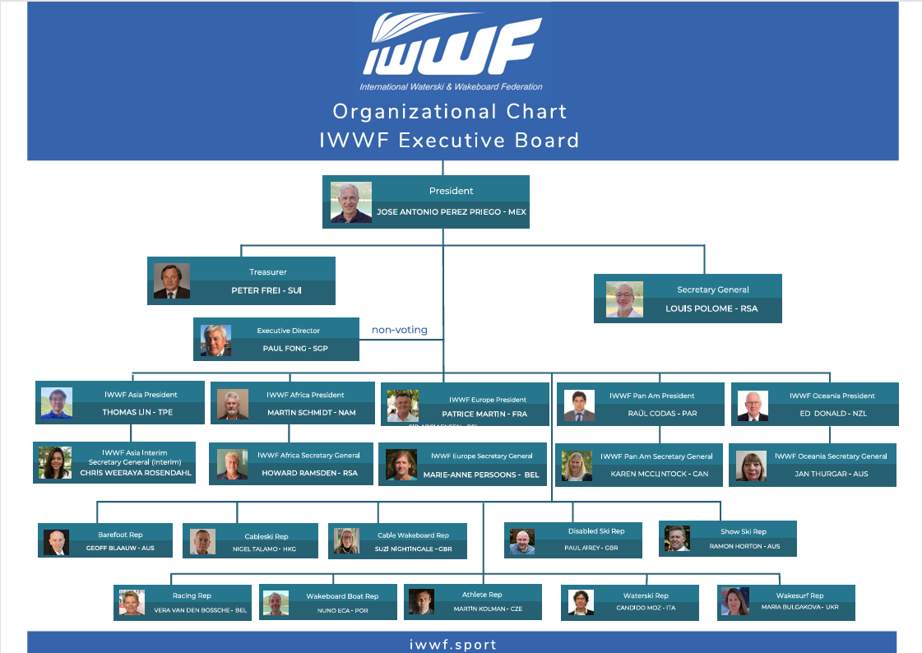
International Waterski & Wakeboard Federation (IWWF)

Slide 25
Water Ski & Wakeboard Australia
IWWF
Oceania
WAWA
CEO & Admin
TWSA
Barefoot
Show
Wake
Disabled
States
Cable Wake
Committee
Ski Race

Slide 26
Ski Racing Australia
July 2001: changed from an active division of AWSA to an affiliated group.
Insurance needs.
Competition needs.
National body handles memberships and rules.
State body organises competitions.

Slide 27

Legal Obligations
Waterski & Wakeboard Australia
admin@awwf.com.au
08 9361 1005
December 2024
Notes:
Advanced User Systems is the Australian distributor for Commence.
We provide full sales, support, training and consulting services.
We work through business partners to provide the Commence CRM solutions.

Slide 28
Agenda
WAWA membership.
Insurance Policies.
Sanctioning.
Risk Management.
Duty of Care.
Working with Children.
Notes:
This presentation will take about 15 - 20 minutes and will cover
some background on Commence Corporation: who they are where they have come from, etc
we will then look at the CRM question: what the problem is and how to solve it
then we will look at the Commence CRM solution in more detail
Finally, we will show you a demo of Commence itself.

Slide 29
WAWA Membership
Governing body of Water skiing in Australia.
You must be a WAWA member to become an accredited Coach and keep the accreditation.
As an accredited Coach you can gain the benefits of WAWA membership at authorized ski schools etc.

Slide 30
Insurance Policies
The following policies are for WAWA members.
Public Liability.
Professional Liability.
Product Liability.
Association Liability.
Personal Accident (restricted).
Travel Insurance (restricted).

Slide 31
Sanctioning
All organised events are sanctioned under the WAWA policy.
RMP’s must be in place for sanctioned events.
States or Divisions must authorise sanctions.
Find sanction form on web site.

Slide 32
Risk Management Plans
WAWA affiliated sites must have a current RMP. Updated each year.
Each event must have a RMP. (page 2+3 of sanction request).
Generic RMP available in WAWA office.

Slide 33
Working with Children
All States have a WWC check program.
As an accredited coach you must have a WWC if Coaching children.
Hand out for Vic and NSW.

Slide 34
First Aid Certificate
A coach will most likely be the first person to see an incident occur and is in a prime position to react and assist.
WAWA request that all coaches have a current first aid certificate.

Slide 35
Questions?

Slide 36
Sports Improvement - Conditioning
Waterski and Wakeboard Australia
admin@awwf.com.au
08 9361 1005
December 2024
Notes:
Advanced User Systems is the Australian distributor for Commence.
We provide full sales, support, training and consulting services.
We work through business partners to provide the Commence CRM solutions.

Slide 37
Agenda
Identify needs.
Training guidelines.
Planning for a year: Periodisation.
Age-appropriate conditioning.
Conditioning ideas.
Warm up & Cool down.
Drugs in Sport.
Notes:
This presentation will take about 15 - 20 minutes and will cover
some background on Commence Corporation: who they are where they have come from, etc
we will then look at the CRM question: what the problem is and how to solve it
then we will look at the Commence CRM solution in more detail
Finally, we will show you a demo of Commence itself.

Slide 38
Identify needs
Tricks: power, short bursts, balance, agility, flexibility.
Slalom: strength, balance, anaerobic fitness.
Jump: power, strength, agility, balance, anaerobic fitness.
Racing: Aerobic fitness, muscular endurance, balance.
Barefoot: Anaerobic, strength, agility.

Slide 39
Training Guidelines
Build base general fitness and core strength first.
As fitness increases become more ski specific.
Train muscle groups and movements required.
Train in appropriate positions. E.g. Stand, don’t use benches. You don’t lie down when you ski!!
Consider work to rest ratios - (Slalom: 16 sec high intensity work x 4-6 passes, ski racing: 1hr constant muscle contraction with constant small adjustments)

Slide 40
Training guidelines
Power: 3-4 sets of 2-6 reps heavy weight. Fast contraction. Long rests between sets (2-3mins).
Strength: 3-4 sets, 8-12 reps mod-heavy. Slow contraction. Mod rest b/w sets. (1-2 mins).
Endurance: 3 sets, 12-15 reps low-mod weight. Mod rests (1-2min).
Aerobic fitness: 4-5 sessions/wk. >25mins.
Anaerobic fitness: 2-3 sessions. Interval training.

Slide 41
Planning a year: Periodisation
Vary training depending on stage of season.
Winter: Aerobic fitness, core, and general strength.
Spring: Interval sessions and specific strength with on water training of fundamental skills.
Summer: More time on water. Just maintain fitness.
Autumn: Recovery sessions, injury prevention.

Slide 42
Age appropriate training
5-12yrs: Balance, motor skills, core strength.
12-16yrs: Core, body weight ex’s, aerobic fitness.
12-16yrs: Light resistance only. Focus on good movement patterns, not building strength or size.
16-18yrs: Never lift to failure. Huge injury risk.
>18 yrs: Heavier weights ok. Push aerobic/ interval and core work. Constant variations.
>65yrs: Light weights, flexibility, general fitness.

Slide 43
Core Conditioning
Core body strength is key.
Provides solid foundation.
Stabilises spine, pelvis and shoulder.
Prevents injury.
Improves balance.
E.g. Pilates, balance exercises, fit ball/ Bosu.

Slide 44
Core Body Exercises
Push ups on medicine ball/ bosu/ fitball.
Diagonal sit ups, leg raises.
Planks: front, side, single arm/ single leg.
Squats, lunges, lunges onto bosu or dura disc.
Cable torso twists.
Fit ball exercises.

Slide 45
Leg Strength Exercises
Squats/ lunges/ burpees.
Leg press.
Leg Curls.
Cycling / Stepper.
Toe raise, calf raise.
Box jumps, plyometric exercises.

Slide 46
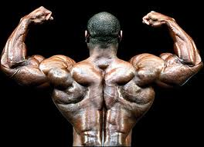
Upper Body Exercises
Chin ups.
Dips.
Lying pull up.
LAT pull down.
Seated row/ Standing row.
Push ups/ bench press.
Dumbbell shoulder press.

Slide 47
Warm up
3-5 mins light exercise.
Elevate heart rate and muscle temperature.
Light jog/ skip.
Arm circles/ windmills.
Rotate wrist.
Star jumps/ tuck jumps.
Use ski movements/ Not static stretching.

Slide 48
Cool Down
Static stretching:
Lengthens muscle.
Hold min 30 seconds. Repeat each stretch twice.
Benefits:
Build flexibility.
Reduces muscle soreness.
Prevent injury.

Slide 49
Drugs in Sport
Australian Sports Anti-Doping Authority
(ADADA www.asada.gov.au)
Banned substances – varies by sports.
Performance enhancing.
Some commonly prescribed.
Social drugs.
Prescriptions should be checked.

Slide 50
Drug Testing
International Events.
State and National Events.
Out of competition testing.
Testing Process:
“Chaperone” stays with athlete.
Require two samples.
Can compete in further events.
Can take part in medal ceremonies.

Slide 51
Questions?

Slide 52
Sport Safety
Waterski and Wakeboard Australia
admin@awwf.com.au
08 9361 1005
December 2024
Notes:
Advanced User Systems is the Australian distributor for Commence.
We provide full sales, support, training and consulting services.
We work through business partners to provide the Commence CRM solutions.

Slide 53
Agenda
Expectations and obligations of the coach.
Injury prevention.
Sun stroke/ heat exhaustion/ hydration.
Hypothermia.
Responding to injury – DRABC.
Responding to injury- RICER.
Responding to injury – no HARM.
Spinal cord injury.
Questions.
Notes:
This presentation will take about 15 - 20 minutes and will cover
some background on Commence Corporation: who they are where they have come from, etc
we will then look at the CRM question: what the problem is and how to solve it
then we will look at the Commence CRM solution in more detail
Finally, we will show you a demo of Commence itself.

Slide 54
Expectations & Obligations of Coach
Provide safe environment for waterskiing.
Have basic level first aid and CPR knowledge.
Ensure skier has appropriate skiing equipment.
Consider safety and ability of skier at all times.

Slide 55
Injury Prevention
Appropriate and correct fitting buoyancy vests.
Correct fitting & maintained skis/ bindings/ helmet/ ropes/ handles.
Drive at speed appropriate to skiers ability.
Ski in clear daylight hours only and in suitable water conditions.
Ski in areas clear of obstructions, trees & docks.
Ensure skier knows hand signals.
Be aware of skiers medical/ physical condition.

Slide 56
Heat exhaustion/ Sunburn / Hydration
Heat exhaustion symptoms: Nausea, vomiting, headaches, dizziness, fatigue, weakness, cramps.
Treatment: move to shade, hydrate, lie down, wet clothes or skin.
Remember Slip, Slop, Slap, Sunglasses, Shade.
Hydrate regularly: 200ml/hr, more on hotter days.
H20 or electrolytes (not soft drink/ caffeine/ alcohol).

Slide 57
Hypothermia
Avoid prolonged exposure to water under 20°.
Dry off and change clothes on cold days.
Symptoms: shivering, blue lips, confusion, lethargy.
Treatment: warm dry clothes, drink warm fluid.
Use wetsuits/ dry suits in cold conditions.

Slide 58
Response to injury - DRABC
If skier doesn’t signal OK, get to them immediately.
Danger – check for and eliminate further danger to skier, yourself and others.
Response – check for response. Talk to skier and check for body/ facial movements.
If not responsive start check for signs of life.

Slide 59
DRABC cont.
Airway – ensure a clear airway. Clear any vomit, blood, broken teeth, mouth guard, check tongue.
Breathing –look for rise and fall in chest, put ear to mouth to hear/ feel for breath. If not breathing get victim onto boat or land and give 2 initial breaths. If no sign of life commence CPR.
CPR – 30 cardiac compressions followed by 2 breaths at a rate of approx. 100 compressions per minute.
Continue CPR until signs of life seen or ambulance arrives.

Slide 60
Response to injury - RICER
If injured skier is alert & able to move, follow RICER.
Rest – Get skier comfortable and out of water.
Ice – Apply ice pack to injured area. 15 mins per hour for first 48 hours.
Compression – Bandage or wrap the injured area.
Elevate – Elevate injured area above chest height.
Refer – Refer for professional diagnosis.

Slide 61
Response to Injury – No HARM
As well as RICER be sure to avoid HARM for 48hrs.
Heat: This will increase swelling and inflammation.
Alcohol: Dilates blood vessels, worsens inflammation.
Running: Increases heart rate, worsens inflammation.
Massage: Increases blood flow, and inflammation.

Slide 62
Spinal Cord Injury
If injured skier is alert but unable to move or feel limbs suspect SCI or major fracture.
DON’T lift skier into boat or remove from water.
SUPPORT neck and spine or affected limb in neutral alignment.
SLOWLY get skier to edge of water and wait for ambulance to arrive.

Slide 63
What to do when a Skier/Rider falls
Skier/Rider falls
Signals “ok”
Confirm skier/rider is OK
& can continue skiing
No “ok” signal
but conscious
Able to move and
communicate
Follow RICER and
No HARM
Unable to move
Suspect SCI or
major fracture.
Get to safety and
call 000
No “ok” signal
not responsive
Follow DRABC and
Call 000.

Slide 64
Questions?

Slide 65
Nutrition for Water skiers and Wakeboarders.

Slide 66
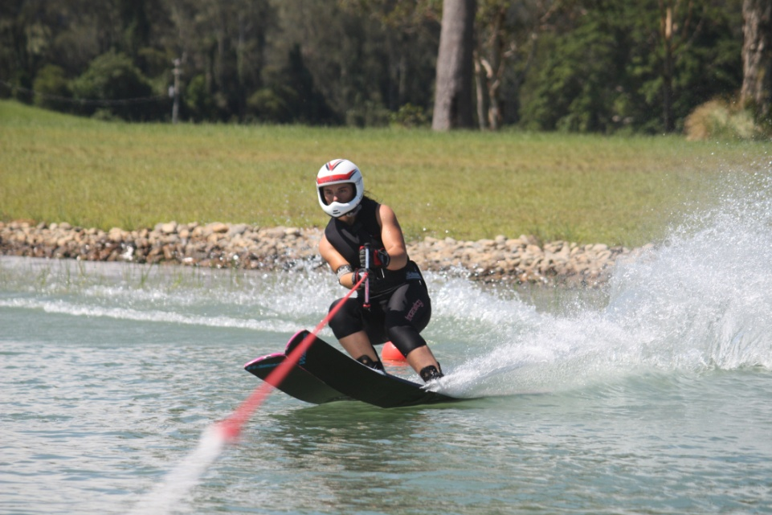
Overview of Presentation
Nutrition goals for athletes.
Day to day nutrition.
Competition nutrition.
Recovery.
Hydration.

Slide 67
Activity: Assessing your competition day diet
Fill out the table:
What you eat on a usual day – include meals and snacks.
Note the timing of each meal, especially around training and competition.

Slide 68


Nutrition challenges for Water Skiers
Fuelling: Varying demands and multiple tournaments
Maintaining muscle mass and strength
Maintaining physical skills → Reduced risk of injury
Maintaining mental skills: Focus and concentration
Recovery between training sessions
Q: Which of these can nutrition have an impact on?

Slide 69
Nutrition challenges for Water Skiers
Fuelling: Varying demands and multiple tournaments
Maintaining muscle mass and strength
Maintaining physical skills → Reduced risk of injury
Maintaining mental skills: Focus and concentration
Recovery between training sessions
Q: Which of these can nutrition have an impact on?
A: All of them!

Slide 70

Nutrition essentials
Nutrients found in a wide range of foods.
Focus on ‘nutrient rich’ foods.
Variety is important.

Slide 71
How do we fuel our bodies?
Eating provides:
Carbohydrate.
Protein.
Fat.
Liver:
Carbohydrate
Adipose tissue:
Fat
Storage
Storage
Blood:
Glucose
Amino acids
Triglycerides
Energy
Muscle:
Carbohydrate
Protein
Fats
Gut

Slide 72
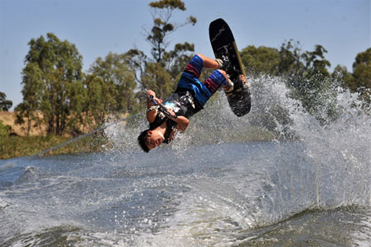
Are you ready to go the distance?
Which of the following is the body’s preferred source of energy during your training or competition days?
Protein.
Carbohydrate.
Fat.
Vitamins.

Slide 73
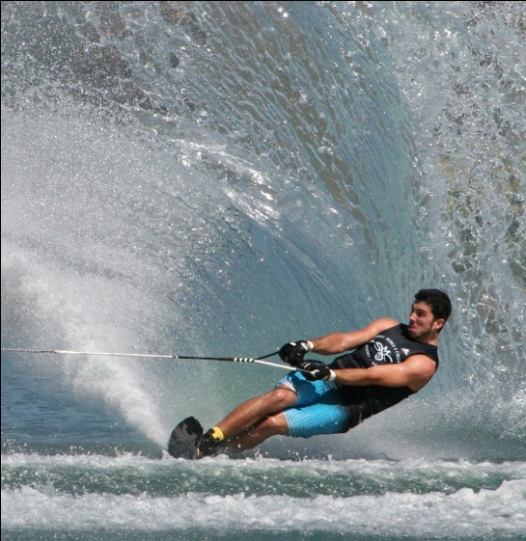
Carbohydrates
Primary fuel source during high intensity exercise
Sessions that get your heart rate up.
Requirements will vary between:
Individuals.
Days of the week.
Training sessions.
Body can only store limited amounts
Needs to be ‘topped up’.
Poor carbohydrate intake can lead to:
Fatigue.
Poor concentration.
Reduced performance.

Slide 74
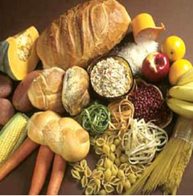
Carbohydrates – Which type
Sugary carbohydrates:
Sugar
Lollies
Soft drinks
Cordial
Sports drinks
Honey
Jams
Jelly
Nutritious Carbohydrates
Breads
Breakfast cereals
Pasta
Rice
Fruit
Starchy vegetables (eg. potato, corn)
Breakfast bars
High fat carbohydrates:
Pastries
Chips
Chocolate
Cakes
Full fat milk

Slide 75
Test your nutrition knowledge
Which food contains little or no carbohydrate?
Low fat yoghurt.
Can of sprite.
Reduced fat cheese.
Reduced fat ice-cream.
One large baked potato.

Slide 76
Test your nutrition knowledge
Which food contains little or no carbohydrate?
Low fat yoghurt (35g)
Can of sprite (30g)
Reduced fat cheese (0g)
Reduced fat ice-cream (30g in 3 scoops)
One large baked potato (30g)

Slide 77
Test your nutrition knowledge
Which food contains little or no carbohydrate?
Low fat yoghurt (35g)
Can of sprite (30g)
Reduced fat cheese (0g)
Reduced fat ice-cream (30g in 3 scoops)
One large baked potato (30g)

Slide 78

Protein
Protein is important for:
Growth.
Increasing muscle mass.
Muscle repair.
Hard training can increase protein muscle mass.
It is usually not difficult to meet protein needs.
Food is the easiest, most effective and inexpensive source of protein.
Timing is just as important as the amount.

Slide 79


Protein – which foods?
High biological availability (choose more often)
Lean meat, chicken, fish.
Eggs.
Dairy foods: milk, yoghurt, cheese & custard.
Low biological availability (include a variety)
Legumes.
Lentils.
Nuts and seeds.
Whole grains.

Slide 80


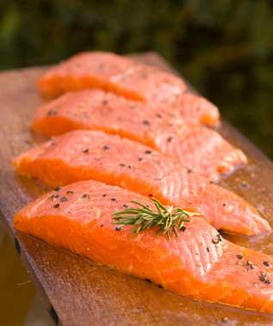
A note on fat...
Can be used a source of fuel during rest and low intensity (aerobic), long duration exercise.
The body has plenty of fat stores.
Fat intake needs to be moderate because:
High body fat levels can decrease speed and endurance.
Can compromise intake of high-quality carbohydrates, and protein.
Focus on ‘good’ fats:
Plant and fish based.

Slide 81
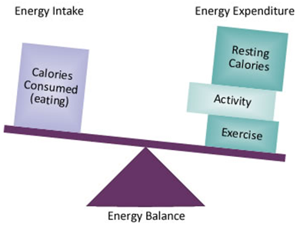
Energy balance
Energy in:
Carbs – 16kJ/g
Protein – 17kJ/g
Fat – 37kJ/g
Energy out:
BMR – 60-80%
Eating ̴ 10%
Exercise – 15-30%

Slide 82

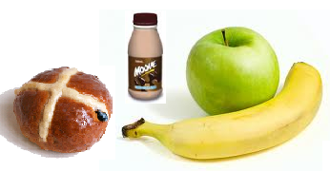
Snack comparison
2200kJ
25g protein
5g fat
5g carbohydrate
2200kJ
7g protein
33g fat
50g carbohydrate

Slide 83
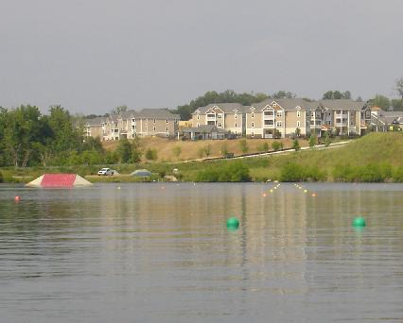
Tournament day

Slide 84
Pre-exercise/competition
Meal | Snack
Pasta/rice with tomato based sauce | Banana
Lean meat & salad roll & fruit | Yoghurt
Crumpets with jam & fruit smoothie | Sports drink
Toast with jam & sports drink | Juice
Sandwich & low fat yoghurt | Jam sandwich
Fruit salad & low fat yoghurt | Cereal bar
Pre exercise meal
Goals:
Top up carbohydrate stores and optimise hydration.
When (individuals):
2-4 hours before exercise – main meal.
< 1 hour before exercise – top up snack.
What:
High carbohydrate.
Low fat and fibre.
Steady fluid intake.
Choose familiar foods.
If nervous, liquids are a good option.

Slide 85

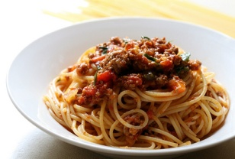

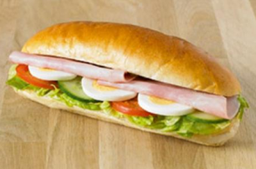



Competition day nutrition
2-4 hours or or +
60 mins or or +
Tournament

Slide 86
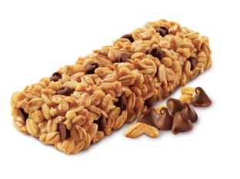

During competition
Goal: to maintain optimal mental acuity and skill set (agility, balance, concentration.)
How? Keep body well fuelled and hydrated.
‘Early and often’.
Make use of breaks between events.
What:
Easily digested carbohydrates.
Form (solid or liquid) depends on type tolerance.
Sports drink can be useful as both carbohydrates & fluid.

Slide 87
Fuelling multiple events
Challenges:
Time available between events.
Time of day.
Availability/suitability of food at venue.
Storage of food taken to event.
Flavour fatigue.
Gastrointestinal tolerance.
Other commitments (warm up, cool down, interviews).
What to eat depends on time available between events:
TIME | FOOD CHOICES
30-60 minutes | Sports drinks, fruit, cereal bars.
1-2 hours | Up&Go, sandwich, yoghurt, low fat muffins, pikelets.
> 2 hours | Pasta/noodle/rice-based dishes with low fat sauce, sandwich.

Slide 88
Post competition - Recovery
Key window = ̴ 60 minutes after skiing.
4 R’s of Recovery:
Rehydrate with fluids and electrolytes.
Replenish muscle glycogen stores with carbohydrates.
Repair and rebuild muscle tissue with protein.
Rest is important to revitalise the body.
Recovery targets can usually be met with food .
Don’t need to rely on supplements.

Slide 89
Recovery – meal or snack
How long until my next main meal?
More than 1 hour
Meal can be your recovery food
Less than 1 hour
A recovery snack is a good idea
Preparation and organisation is essential!

Slide 90



Recovery options
Recovery snacks:
Fruit smoothie.
Liquid meal replacement.
Sandwich with lean meat.
Fruit salad with low fat yoghurt.
1-2 cereal bars.
Muesli bar & low-fat yoghurt.
Creamed rice.
English muffin with peanut butter.
Recovery meals:
Cereal with milk.
Pasta with meat sauce.
Chicken risotto.
Beef burritos.
Baked potato with beans and cheese.

Slide 91
Hydration and performance
Fluid loss from the body
Need to drink fluids to minimise this loss
Sweat to keep body temperature optimum
.
otherwise

Slide 92
Effects of dehydration
↓ high intensity performance
Impaired decision making
↓ skill level
Just 2% loss of body weight can impact on performance
↓ power output
Earlier fatigue
Need to replace 150% of fluid losses
↑ injury risk
↑ perception of effort
↓ endurance

Slide 93


Factors affecting hydration status
Losses: (sweat rate)
Genetics.
Body size.
Fitness.
Environment.
Exercise intensity.
Exercise duration.
Intake:
Availability .
Type of fluid (electrolyte, carb).
Temperature of fluid.
Taste of fluid.

Slide 94
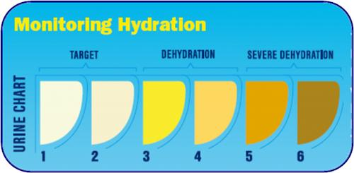
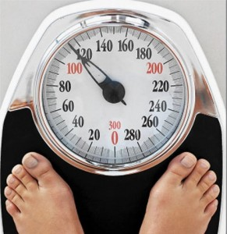
Monitoring hydration status
Urine colour.
Urine volume.
Body weight.
Specific gravity.

Slide 95

Water vs sport drink
Situations for use:
Best fluid to drink during the day.
During and after easy training sessions, especially if <60 minutes.
Situations for use:
During or after prolonged workouts or competition 60-9o minutes).
When fluid losses are likely to be high (hot conditions).
When you need fuel as well as fluid.

Slide 96
To rehydrate after a race I need to:
Drink a litre of fluid straight away.
Aim to replace 100% of losses.
Aim to replace 150% of losses over the next 4-6 hours.
Don’t worry about it.

Slide 97
To rehydrate after a race I need to:
Drink a litre of fluid straight away.
Aim to replace 100% of losses.
Aim to replace 150% of losses over the next 4-6 hours.
Don’t worry about it.

Slide 98
Meeting nutrition challenges for water-skiing
Fuelling:
Varying length and demands of races
Multiple tournaments.
Meeting carbohydrate requirements
Matching carbohydrates to training demands.
Maintaining physical skills → reduced risk of physical injury.
Meeting protein requirements.
Maintaining muscle mass (and strength).
Balanced diet with lots of variety
Optimal hydration.
Maintaining mental skills – focus and concentration.
Hydration and maintaining carbohydrate stores.
Recovery between training sessions.
4 R’s of Recovery.

Slide 99


Useful resources
Australian institute of Sports Website
www.ausport.gov.au/ais/nutrition
AIS Survival cookbook series

Slide 100
Activity – assessing your tournament day diet
Fill out the first column in the table:
What you eat on a usual day – include meals and snacks.
Note the timing of each meal.
What fluids do you consume?
Now fill out the second column in the table:
What strategies can you use to improve nutrition?
Think about the nutrition goals.
Think about nutrient density.
Think about timing of exercise.
What about hydration.

Slide 101
Coaching Water Skiers with disabilities
Waterski and Wakeboard Australia
admin@awwf.com.au
08 9361 1005
December 2024
Notes:
Advanced User Systems is the Australian distributor for Commence.
We provide full sales, support, training and consulting services.
We work through business partners to provide the Commence CRM solutions.

Slide 102
Agenda
Relating to people with disabilities.
Types of Disabilities.
Safety.
Equipment.
Notes:
This presentation will take about 15 - 20 minutes and will cover
some background on Commence Corporation: who they are where they have come from, etc
we will then look at the CRM question: what the problem is and how to solve it
then we will look at the Commence CRM solution in more detail
Finally, we will show you a demo of Commence itself.

Slide 103
Communication tips
Be yourself.
Communicate appropriate to age.
Ensure you understand.
Ask before helping.
Be patient, let skier set the pace.
Understand the disability.

Slide 104
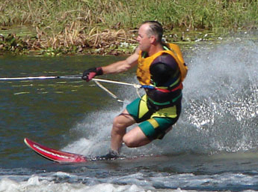
Types of Disabilities
Leg disability.
Arm disability.
Spinal cord injury.
Vision impairment.

Slide 105
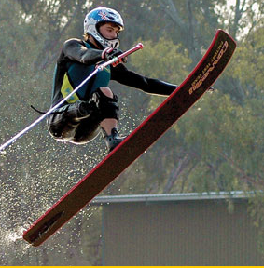
Leg Disability
Consider level of amputation.
Prosthesis.
Equipment adapted.
Triple bar.
Double leg amputee – sit ski.
Single leg amputee – out slalom course.

Slide 106
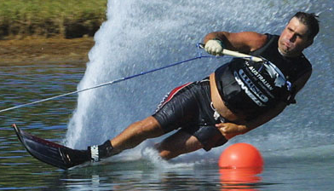
Arm Disability
Amputation.
Paralysed. (bracchial plexus)
Delgar Sling.
Signals:
Nod upward – increase speed.
Nod downward – reduce speed.
Diagonal twist – return to dock.

Slide 107
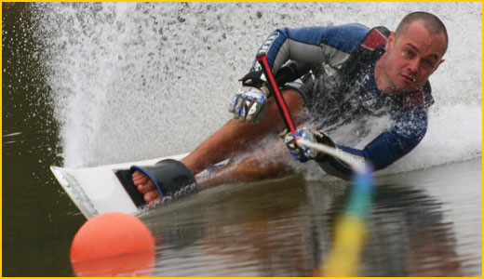
Spinal Cord Injury
Paraplegia - lower limbs.
Quadriplegia - four limbs.
Causes:
Motor vehicles, diving, falls, sports.
Often risk-taking accidents: majority males 17 – 25 years.

Slide 108
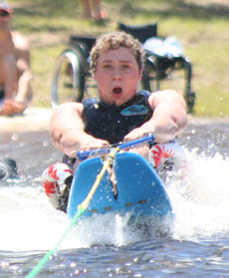
Spinal Cord Injury - Implications
Usually sit skiers.
Assistance with lifting.
Outriggers.
Delgar sling.
Watch for fatigue.
Must complete water test.

Slide 109
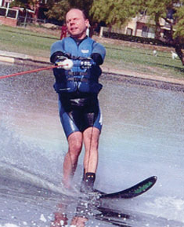
Vision Impairment
May have some degree of vision.
Cannot see at 6m what can normally be seen at 60m.

Slide 110
Vision Impairment
Speak distinctly.
Announce presence or intention to leave.
Introduce people around you.
Speak naturally, specific directions.
Warn of possible dangers, e.g. slippery area.

Slide 111
Vision Impairment - Learning
Cannot learn by watching others.
Full description.
Feel the position and movements.
Demo – by feel.
Greater level of feedback and correction.

Slide 112
Vision Impairment - Signals
Whistle is essential.
1 short blast. Water clear, safe to cross wake.
2 short blasts. Return to centre of wake.
1 long blast. Release handle, controlled stop.

Slide 113
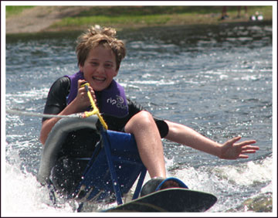
Safety Issues
Water test.
Skier and assistants to wear buoyancy.
Assistants ready to get in water.
Be aware of risks.
Quick release.

Slide 114
Water Test
Not the same as a pool.
Cold water & turbulence.
Wet suit and buoyancy vest.
Ensure can get on back after a fall.
Assist skier to lie on back.
Unaided, skier rolls over confidently and safely, both directions.
Face goes underwater.

Slide 115
Equipment
Deglar sling.
Sit skis and seats (cages).
Spacers and riser plates.
Triple bar.
Ski tip connectors.
Outriggers.

Slide 116
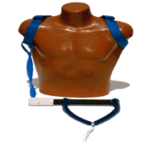
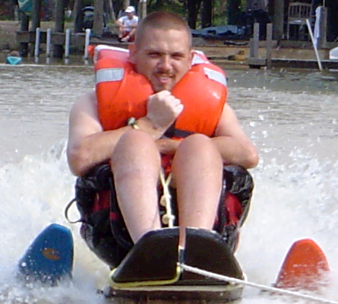
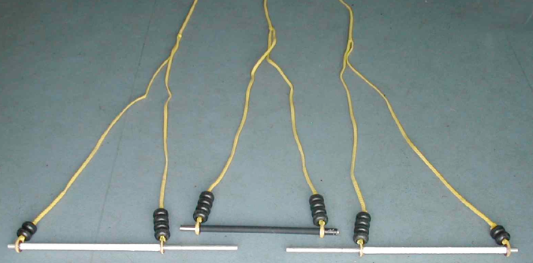
Equipment

Slide 117
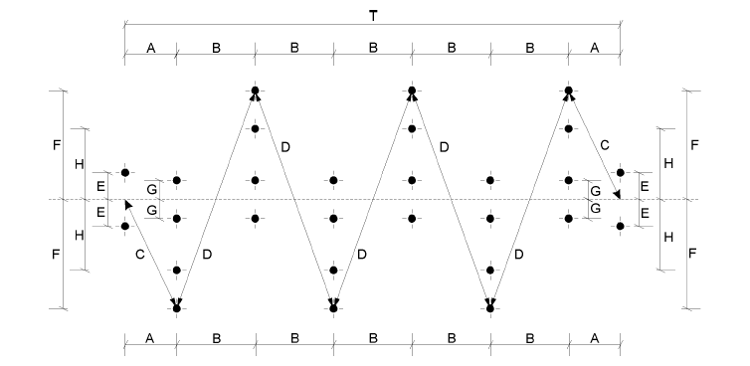
Slalom course
Some use mid-buoy slalom course.
Dimension H – 6.4m (usual F – 11.5m).

Slide 118
Lifting
Avoid back injury.
Ask skier how best to assist.
When lifting:
Two people, one takes lead.
Get close to the person.
Feet apart.
Bend knees and keep back straight.

Slide 119
Wheel Chair
Usually will only need assistance in difficult terrain.
Ask before helping.
For stairs, ramps, etc ask how skier would like to proceed.

Slide 120
Resources
http://www.disabledwaterski.com.au
http://www.usawaterski.org/pages/ divisions/WSDA/main.htm
http://www.usawaterski.org/pages/ divisions/WSDA/ AdaptiveWaterSkiEquipment.pdf
http://www.spokesnmotion.com/catalog/category.asp?category_id=102

Slide 121
Questions?

